Slide 1

2017
大气简洁欧美风年终总结PPT模板
锐旗设计
2016.01.1
Notes:
版权声明：300套精品模板商业授权，请联系【锐旗设计】:https://9ppt.taobao.com，专业PPT老师为你解决所有PPT问题！

Slide 2
LOGO
CONTENTS
Books possess an essence of immortality.
They are by far the most lasting products of
human effort. Temples and statues decay, but
books survive.
01
ABOUT OUR BUSINESS
02
DATA ANALYSIS
03
OUR SERVICE
04
PORTFOLIO

Slide 3

LOGO
The First Part
ABOUT OUR BUSINESS
Books possess an essence of immortality. They are by far the most
lasting products of human effort. Temples and statues decay, but
books survive.

Slide 4


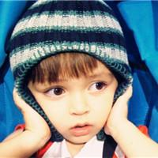

ABOUT OUR TEAM
Books possess an essence of immortality. They are by far the most lasting products of human effort. Temples and statues decay, but books survive.
ADD YOUR NAME
ADD YOUR NAME
ADD YOUR NAME
ADD YOUR NAME
You Can't Un-ring a Bell. No one can change what's already happened. Whatever is done is done. It's up to us whether we use the experience to learn or allow ourselves to be run by the
experience.
You Can't Un-ring a Bell. No one can change what's already happened. Whatever is done is done. It's up to us whether we use the experience to learn or allow ourselves to be run by the
experience.
You Can't Un-ring a Bell. No one can change what's already happened. Whatever is done is done. It's up to us whether we use the experience to learn or allow ourselves to be run by the
experience.
You Can't Un-ring a Bell. No one can change what's already happened. Whatever is done is done. It's up to us whether we use the experience to learn or allow ourselves to be run by the
experience.

Slide 5

ABOUT OUR TEAM
Books possess an essence of immortality. They are by far the most lasting products of human effort. Temples and statues decay, but books survive.
sunshine without shade
all pleasure without pain, is not life at all. Take the lot of the happiest - it is a tangled yarn. pleasure without pain, is not life at all. Take the lot of the happiest - it is a tangled yarn.
sunshine without shade
all pleasure without pain, is not life at all. Take the lot of the happiest - it is a tangled yarn. pleasure without pain, is not life at all. Take the lot of the happiest - it is a tangled yarn.
sunshine
sunshine
sunshine
sunshine

Slide 6

ABOUT OUR Team
Books possess an essence of immortality. They are by far the most lasting products of human effort. Temples and statues decay, but books survive.
DESIGN
Youth is not a time of life; it is a state of mind; it is not a matter of rosy cheeks, red lips and
CONCEPTION
Youth is not a time of life; it is a state of mind; it is not a matter of rosy cheeks, red lips and
MARKETING
Youth is not a time of life; it is a state of mind; it is not a matter of rosy cheeks, red lips and
DESIGN
76%
CODING
70%
CONCEPTION
50%
SOCIAL MARKETING
MARKETING
80%
Youth is not a time of life; it is a state of mind; it is not a matter of rosy cheeks, red lips and
SOCIAL MARKETING
88%
Notes:
版权声明：300套精品模板商业授权，请联系【锐旗设计】:https://9ppt.taobao.com，专业PPT老师为你解决所有PPT问题！

Slide 7
ORGANIZATIONAL STRUCTURE
Books possess an essence of immortality. They are by far the most lasting products of human effort. Temples and statues decay, but books survive.
SEO ANALYSIS
HEADING FOR THIS TEXTS
But all sunshine without shade, all pleasure without pain, is not life at all. Take the lot of the happiest - it is a tangled yarn. Bereavements and blessings, one following another, make us sad and blessed by turns. pleasure without pain, is not life at all. Take the lot of the happiest - it is a tangled yarn. Bereavements and blessings, one following another, make us following another, make us sad and blessed by
FACT ONE
Professional
But all sunshine without shade, all pleasure without pain, is not life at all.
FACT TWO
Efficient
But all sunshine without shade, all pleasure without pain, is not life at all.
SUCCESS
But all sunshine without shade, all pleasure without pain, is not life at all. Take the lot of the happiest - it is a tangled yarn.
Responsibility
FACT THREE
But all sunshine without shade, all pleasure without pain, is not life at all.

Slide 8
ORGANIZATIONAL STRUCTURE
Books possess an essence of immortality. They are by far the most lasting products of human effort. Temples and statues decay, but books survive.
ADD YOUR TITLE
ADD YOUR TITLE
ADD YOUR TITLE
ADD YOUR TITLE
If You Don't Believe in Yourself, No One Else Will. People don't respect or follow anyone who doesn't have confidence in themselves. I think the Universe tends to trust us to the degree we trust ourselves.
If You Don't Believe in Yourself, No One Else Will. People don't respect or follow anyone who doesn't have confidence in themselves. I think the Universe tends to trust us to the degree we trust ourselves.
If You Don't Believe in Yourself, No One Else Will. People don't respect or follow anyone who doesn't have confidence in themselves. I think the Universe tends to trust us to the degree we trust ourselves.
If You Don't Believe in Yourself, No One Else Will. People don't respect or follow anyone who doesn't have confidence in themselves. I think the Universe tends to trust us to the degree we trust ourselves.
THE KEY WORD
THE KEY WORD
THE KEY WORD
THE KEY WORD

Slide 9

LOGO
The Second Part
DATA ANALYSIS
Books possess an essence of immortality. They are by far the most
lasting products of human effort. Temples and statues decay, but
books survive.

Slide 10
DATA ANALYSIS
Books possess an essence of immortality. They are by far the most lasting products of human effort. Temples and statues decay.
The Title Of The Chart
+ 15%
Truck
Thus the best books are treasuries of good words, the golden thoughts, which, remembered and cherished, become our constant companions and comforters.
- 23%
Plane
Thus the best books are treasuries of good words, the golden thoughts, which, remembered and cherished, become our constant companions and comforters.

Slide 11
DATA ANALYSIS
Books possess an essence of immortality. They are by far the most lasting products of human effort. Temples and statues decay.
+
BRAND STRATEGY
76%
Youth is not a time of life; it is a state of mind; it is not a matter of rosy cheeks, red lips and supple knees;
68%
60%
57%
56%
45%
BRAND STRATEGY
20%
+
18%
Youth is not a time of life; it is a state of mind; it is not a matter of rosy cheeks, red lips and supple knees;
09%
12%
23%
-
BRAND STRATEGY
Youth is not a time of life; it is a state of mind; it is not a matter of rosy cheeks, red lips and supple knees;
34%

Slide 12
DATA ANALYSIS
Books possess an essence of immortality. They are by far the most lasting products of human effort. Temples and statues decay.
59%
59%
59%
59%
123,456
123,456
123,456
123,456
Revenue
Revenue
Revenue
Revenue
But all sunshine without shade, all pleasure without
But all sunshine without shade, all pleasure without
But all sunshine without shade, all pleasure without
But all sunshine without shade, all pleasure without

Slide 13
DATA ANALYSIS
Books possess an essence of immortality. They are by far the most lasting products of human effort. Temples and statues decay.
Project 01
A good book is often the best urn of a life enshrining the best that life could think out; for the world of a man’s life is, for the most part, but the world of his thoughts. Thus the best books are treasuries of good words, the golden thoughts, which, remembered and cherished, become our constant companions and comforters.
Project 02
A good book is often the best urn of a life enshrining the best that life could think out; for the world of a man’s life is, for the most part, but the world of his thoughts. Thus the best books are treasuries of good words, the golden thoughts, which, remembered and cherished, become our constant companions and comforters.
Project 03
A good book is often the best urn of a life enshrining the best that life could think out; for the world of a man’s life is, for the most part, but the world of his thoughts. Thus the best books are treasuries of good words, the golden thoughts, which, remembered and cherished, become our constant companions and comforters.
Notes:
版权声明：300套精品模板商业授权，请联系【锐旗设计】:https://9ppt.taobao.com，专业PPT老师为你解决所有PPT问题！

Slide 14
DATA ANALYSIS
Books possess an essence of immortality. They are by far the most lasting products of human effort. Temples and statues decay.
Mobile Access
But all sunshine without shade, all pleasure without
59%
Mobile Access
But all sunshine without shade, all pleasure without
Mobile Access
But all sunshine without shade, all pleasure without sunshine wit
Mobile Access
But all sunshine without shade, all pleasure
Mobile Access
But all sunshine without shade, all pleasure without sunshine wit

Slide 15
LOGO
The Third Part
OUR SERVICE
Books possess an essence of immortality. They are by far the most
lasting products of human effort. Temples and statues decay, but
books survive.

Slide 16
ABOUT OUR Team
Books possess an essence of immortality. They are by far the most lasting products of human effort. Temples and statues decay, but books survive.
DESIGN
Youth is not a time of life; it is a state of mind; it is not a matter of rosy cheeks, red lips and
CONCEPTION
Youth is not a time of life; it is a state of mind; it is not a matter of rosy cheeks, red lips and
MARKETING
Youth is not a time of life; it is a state of mind; it is not a matter of rosy cheeks, red lips and
DESIGN
76%
CODING
70%
CONCEPTION
50%
SOCIAL MARKETING
MARKETING
80%
Youth is not a time of life; it is a state of mind; it is not a matter of rosy cheeks, red lips and
SOCIAL MARKETING
88%

Slide 17
OUR SERVICE
Books possess an essence of immortality. They are by far the most lasting products of human effort. Temples and statues decay.
DESIGN
it is not a matter of rosy cheeks, red lips and supple knees; it is a matter of the will,
CODING
it is not a matter of rosy cheeks, red lips and supple knees; it is a matter of the will,
CONCEPTION
it is not a matter of rosy cheeks, red lips and supple knees; it is a matter of the will,
MARKETING
it is not a matter of rosy cheeks, red lips and supple knees; it is a matter of the will,
SOCIAL MARKETING
it is not a matter of rosy cheeks, red lips and supple knees; it is a matter of the will,

Slide 18
OUR SERVICE
Books possess an essence of immortality. They are by far the most lasting products of human effort. Temples and statues decay.
Just for today I will exercise my soul in three ways. I will do somebody a good turn and not get found out: If anybody knows of it, it will not count. I will do at least two things I don‘t want to do—just for exercise. I will not show anyone that my feelings are hurt: they may be hurt, but today I will not show it.
Just for today I will exercise my soul in three ways. I will do somebody a good turn and not get found out: If anybody knows of it, it will not count. I will do at least two things I don‘t want to do—just for exercise. I will not show anyone that my feelings are hurt: they may be hurt, but today I will not show it.
Just for today I will exercise my soul in three ways. I will do somebody a good turn and not get found out: If anybody knows of it, it will not count. I will do at least two things I don‘t want to do—just for exercise. I will not show anyone that my feelings are hurt: they may be hurt, but today I will not show it.
Just for today I will exercise my soul in three ways. I will do somebody a good turn and not get found out: If anybody knows of it, it will not count. I will do at least two things I don‘t want to do—just for exercise. I will not show anyone that my feelings are hurt: they may be hurt, but today I will not show it.
Just for today I will exercise my soul in three ways. I will do somebody a good turn and not get found out: If anybody knows of it, it will not count. I will do at least two things I don‘t want to do—just for exercise. I will not show anyone that my feelings are hurt: they may be hurt, but today I will not show it.
Just for today I will exercise my soul in three ways. I will do somebody a good turn and not get found out: If anybody knows of it, it will not count. I will do at least two things I don‘t want to do—just for exercise. I will not show anyone that my feelings are hurt: they may be hurt, but today I will not show it.

Slide 19



OUR SERVICE
Books possess an essence of immortality. They are by far the most lasting products of human effort. Temples and statues decay.
02
ADD YOUR TITLE
Clarity Leads to Power. When we're clear, we're more effective. Our clarity reduces our mistakes and enables us to enlist the help of others.
01
ADD YOUR TITLE
03
ADD YOUR TITLE
Clarity Leads to Power. When we're clear, we're more effective. Our clarity reduces our mistakes and enables us to enlist the help of others.
Clarity Leads to Power. When we're clear, we're more effective. Our clarity reduces our mistakes and enables us to enlist the help of others.

Slide 20
LOGO
The Fourth Part
PORTFOLIO
Books possess an essence of immortality. They are by far the most
lasting products of human effort. Temples and statues decay, but
books survive.

Slide 21

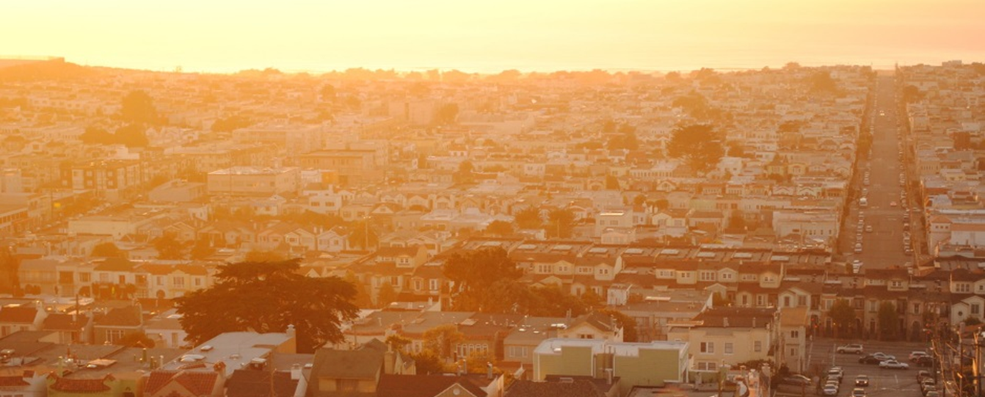

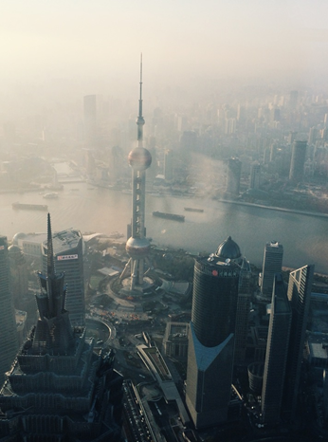

Just for today I will exercise my soul in three ways. I will do somebody a good turn and not get found out: If anybody knows of it, it will not count. I will do at least two things I don‘t want to do—just for exercise. I will not show anyone that my feelings are hurt: they may be hurt, but today I will not show it.
PORTFOLIO
Books possess an essence of immortality. They are by far the most lasting products of human effort. Temples and statues decay.
Notes:
版权声明：300套精品模板商业授权，请联系【锐旗设计】:https://9ppt.taobao.com，专业PPT老师为你解决所有PPT问题！

Slide 22



PORTFOLIO
I will do at least two things I don‘t want to do—just for exercise. I will not show anyone that my feelings are hurt: they may be hurt, but today I will not show it.
Just for today I will exercise my soul in three ways. I will do somebody a good turn and not get found out: If anybody knows of it, it will not count.
Books possess an essence of immortality. They are by far the most lasting products of human effort. Temples and statues decay.

Slide 23
OUR SERVICE
Books possess an essence of immortality. They are by far the most lasting products of human effort. Temples and statues decay.
MARKETING KEYS
HEADING FOR THIS TEXTS
But all sunshine without shade, all pleasure without pain, is not life at all. Take the lot of the happiest - it is a tangled yarn. Bereavements and blessings, one following another, make us sad and blessed by turns. pleasure without pain, is not life at all. Take the lot of the happiest - it is a tangled yarn. Bereavements and blessings, one following another, make us following another, make us sad and blessed by

Slide 24
OUR SERVICE
Books possess an essence of immortality. They are by far the most lasting products of human effort. Temples and statues decay.
CLOUD ANALYSIS
HEADING FOR THIS TEXTS
But all sunshine without shade, all pleasure without pain, is not life at all. Take the lot of the happiest - it is a tangled yarn. Bereavements and blessings, one following another, make us sad and blessed by turns. pleasure without pain, is not life at all. Take the lot of the happiest - it is a tangled yarn. Bereavements and blessings, one following another, make us following another, make us sad and blessed by
HEADING FOR THIS
2.2M
1.2M
45M
4.5M
0.8M
But all sunshine without shade, all pleasure without pain, is not life at all. Take the lot of the happiest - it is a tangled yarn. Bereavements and blessings, one following another

Slide 25
LOGO
2017
THANK YOU FOR WATCHING
COMPANY NAME
2014.08.25
Notes:
版权声明：300套精品模板商业授权，请联系【锐旗设计】:https://9ppt.taobao.com，专业PPT老师为你解决所有PPT问题！

Slide 26


Slide 27


